Slide 1

DragonEvents
Notes:
Harley

Slide 2
Team
Harley Sacramento- Project Manager
Rahul Godaba- Technical/DB Developer
Saffat Hasan- Technical/DB Developer
Haley Lee- Frontend Developer
Nicholas Nguyen- Frontend Developer/ Project Status Manager
Notes:
Harley

Slide 3
Problem Statement
DragonEvents will be a website for Drexel Students to see and submit events
An improvement to the already existing Drexel Events website
The events will allow users to be notified about any events and activities that they can participate in
Notes:
Harley

Slide 4
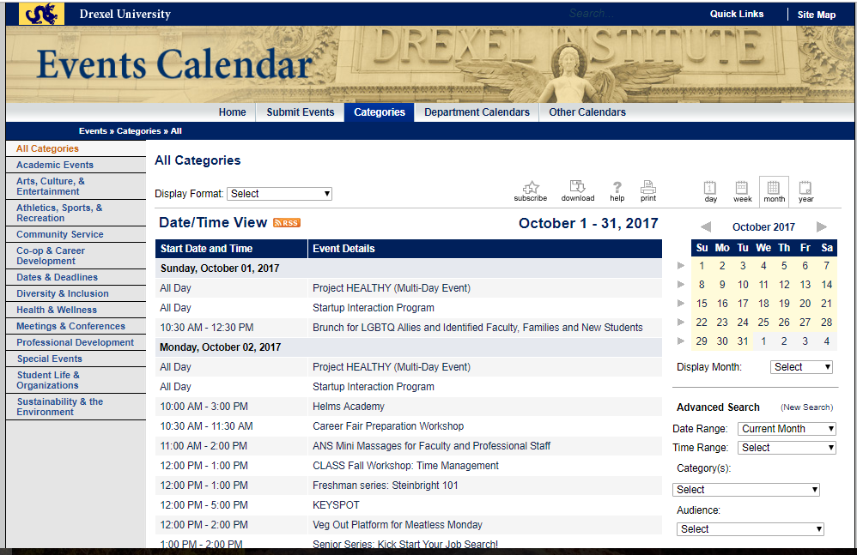

Slide 5
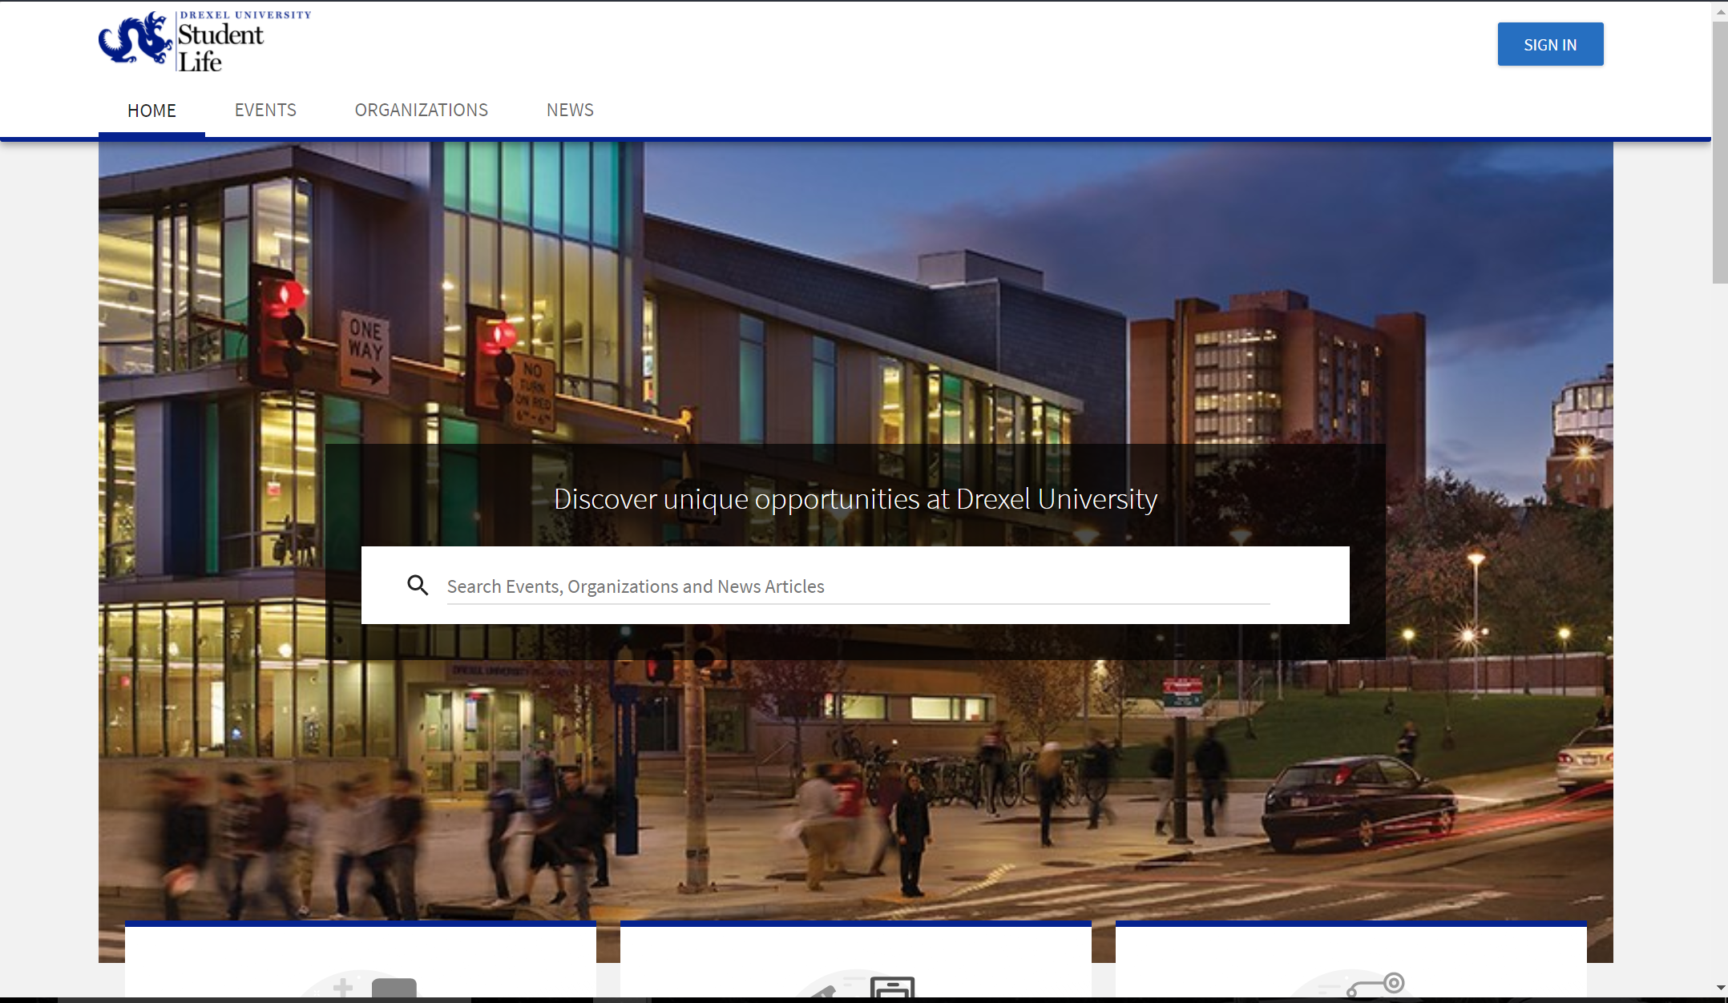

Slide 6
Project Scope
Essential Deliverables
DragonEvents will be created on its own server
Posts can be submitted with a description and date
Users can select a feedback ‘interested’ or ‘going’ to an event
Incremental Deliverables
Report an event for verifying its legitimacy
Users are able to filter the events of their interest and sort them in certain order such as date/time or popularity
Notes:
Rahul
Everyone hears about the larger events that occur on campus, but the smaller ones should have an attendance as well. We aim to create a website where all events at Drexel will be seen by users.

Slide 7
Project Scope- contd.
3. Future Enhancements
Non-Drexel student users are able to create a premium account for a fee and they can create sponsored events without generating spam.
Scraping data from Facebook/DrexelEvents/Dragonlinks

Slide 8
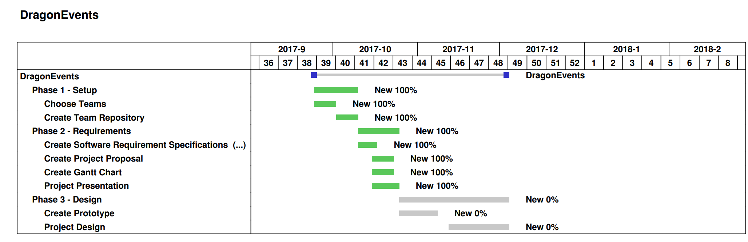
Summary of Project Activities
Notes:
Saffat
Here is our Gantt chart which you can see our progress. We’re already completed with most of things.
We divided the work this quarter into three major phases: Setup, Requirements, and Design. As you can see we are currently on track and have completed phase 2 and next week we will be starting phase 3, Design.

Slide 9
Technologies
What technology/resources will we need for the project?
Server: This will handle the back end portion of our website. Possible software:Apache HTTP, Linux, MySQL etc.
Domain: This will identify DragonEvents as belonging to a particular domain. Possible software:PowerDNS, BIND, Unbound, etc.
Notes:
Nicholas
Server :Apache, linux
Domain: Any possible DNS softwares

Slide 10
Technologies- contd.
What technologies will we learn to use during this process?
Database
Computer Networking
Creating effective UI
Notes:
Nicholas

Slide 11
Constraints
Design
User Interface for both students and businesses
Achievable scope
Time frame
Having GPS feature
Web based application
Notes:
Haley
Put screenshot of DrexelEvent and show what we’re aiming for.

